Slide 1
Dr Emmanuel Ahene
Beyond basics –L4
Assembly Language Programming

Slide 2
Sample programs done:
Hello_world.asm ;
displays hello world
Addition.asm / Subtraction.asm ; add/subtract two numbers and display the answer to screen
Compare.asm ;
compares 3 numbers for the greatest
See WhatsApp group for sample codes
Assignment:
Write the compare.asm code in 64 bits. To be submitted on 3/06/2021

Slide 3
Continuing Assembly Registers
Registers (32/64Bits) are grouped into three categories:
General registers
Control registers
Segment register

Slide 4
PROCESSOR REGISTERS (32 & 64 bits)
The general registers are further divided into the following groups:
Data registers
Pointer registers
Index registers

Slide 5
Pointer Registers
Stack Pointer (SP) - SP in association with the SS register (SS:SP) refers to be current position of data or address within the program stack.
the 16-bit SP register provides the offset value within the program stack.
SS – stack segment (procedures) CS: code segment (_text)
DS – data segment (.bss, .data)

Slide 6
Pointer Registers
Base Pointer (BP) - The address in SS register is combined with the offset in BP to get the location of the parameter.
BP can also be combined with DI and SI as base register for special addressing.
The 16-bit BP register mainly helps in referencing the parameter variables passed to a subroutine.
DI – destination index SI – source index

Slide 7
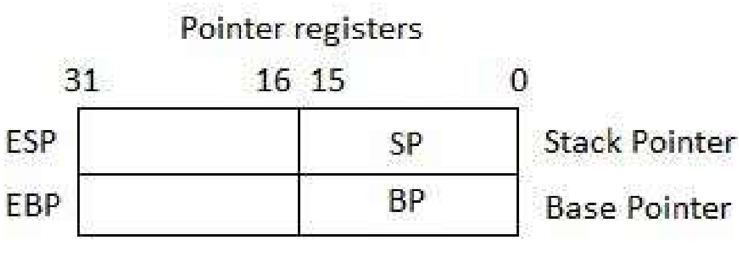
Pointer Registers

Slide 8
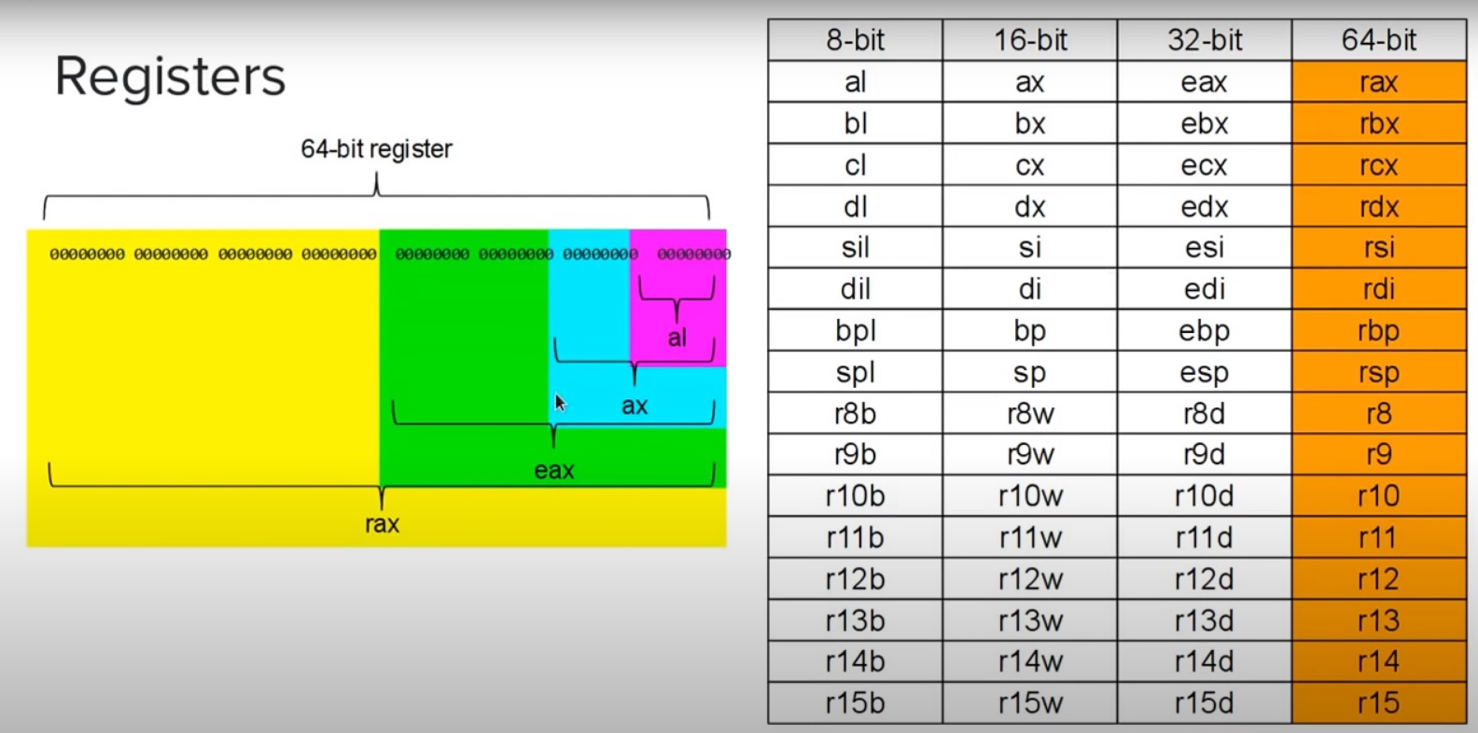
Have a look …..

Slide 9
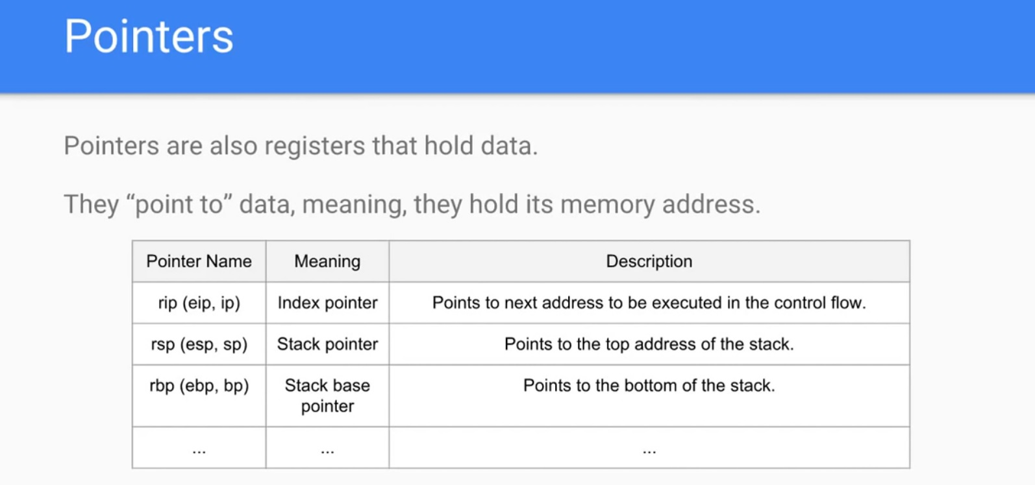
and even more ….

Slide 10
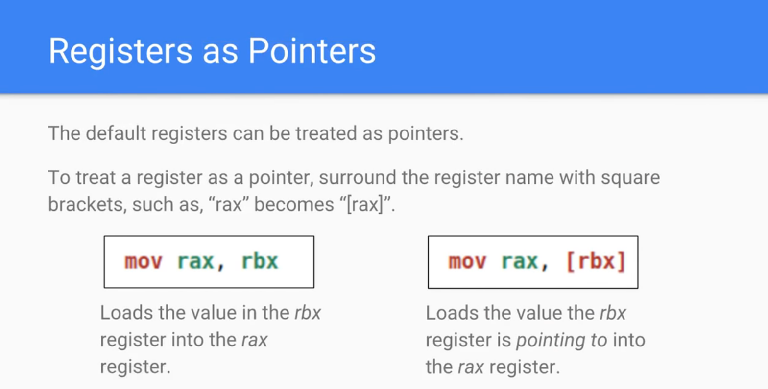

Slide 11
Index Registers
The 32-bit index registers ESI and EDI and their 16-bit rightmost portions SI and DI are used for indexed addressing and sometimes used in addition and subtraction.
There are two sets of index pointers:
Source Index (SI) - it is used as source index for string operations
Destination Index (DI) - it is used as destination index for string operations.

Slide 12
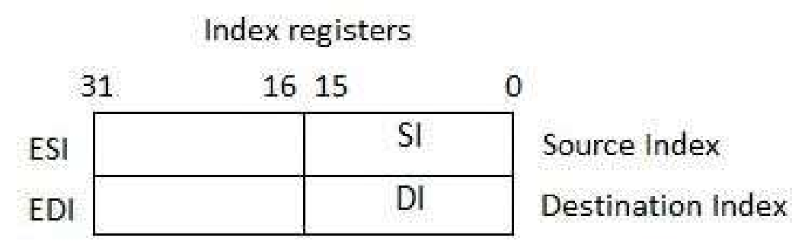
Index Registers

Slide 13
Control Registers
The 32-bit/64 bit instruction pointer register and 32-bit/64 bit flags register combined are considered as the control registers.
Many instructions involve comparisons and mathematical calculations and change the status of the flags and some other conditional instructions test the value of these status flags to take the control flow to other location.

Slide 14
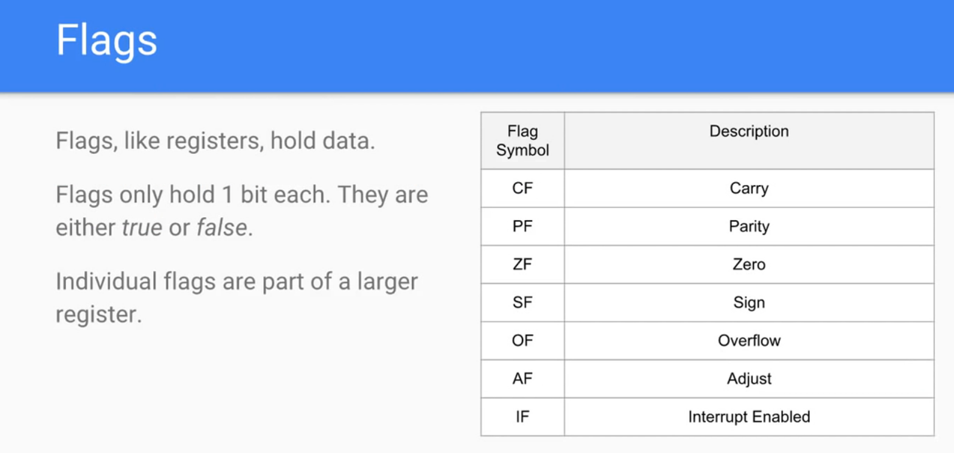

Slide 15
Control Registers
The common flag bits are:
Overflow Flag (OF): indicates the overflow of a high-order bit (leftmost bit) of data after a signed arithmetic operation.
Direction Flag (DF): determines left or right direction for moving or comparing string data. When the DF value is 0, the string operation takes left-to-right direction and when the value is set to 1, the string operation takes right-to-left direction

Slide 16
Control Registers
Interrupt Flag (IF): determines whether the external interrupts like, keyboard entry etc. are to be ignored or processed. It disables the external interrupt when the value is 0 and enables interrupts when set to 1.
Trap Flag (TF): allows setting the operation of the processor in single-step mode. The DEBUG program we used sets the trap flag, so we could step through the execution one instruction at a time.

Slide 17
Control Registers
Sign Flag (SF): shows the sign of the result of an arithmetic operation. This flag is set according to the sign of a data item following the arithmetic operation. The sign is indicated by the high-order of leftmost bit. A positive result clears the value of SF to 0 and negative result sets it to 1.
Zero Flag (ZF): indicates the result of an arithmetic or comparison operation. A nonzero result clears the zero flag to 0, and a zero result sets it to 1

Slide 18
Control Registers
Auxiliary Carry Flag (AF): contains the carry from bit 3 to bit 4 following an arithmetic operation; used for specialized arithmetic. The AF is set when a 1-byte arithmetic operation causes a carry from bit 3 into bit 4.
Parity Flag (PF): indicates the total number of 1-bits in the result obtained from an arithmetic operation. An even number of 1-bits clears the parity flag to 0 and an odd number of 1-bits sets the parity flag to 1.

Slide 19
Control Registers
Carry Flag (CF): contains the carry of 0 or 1 from a high-order bit (leftmost) after an arithmetic operation. It also stores the contents of last bit of a shift or rotate operation.
The following table indicates the position of flag bits in the 16-bit Flags register:

Slide 20
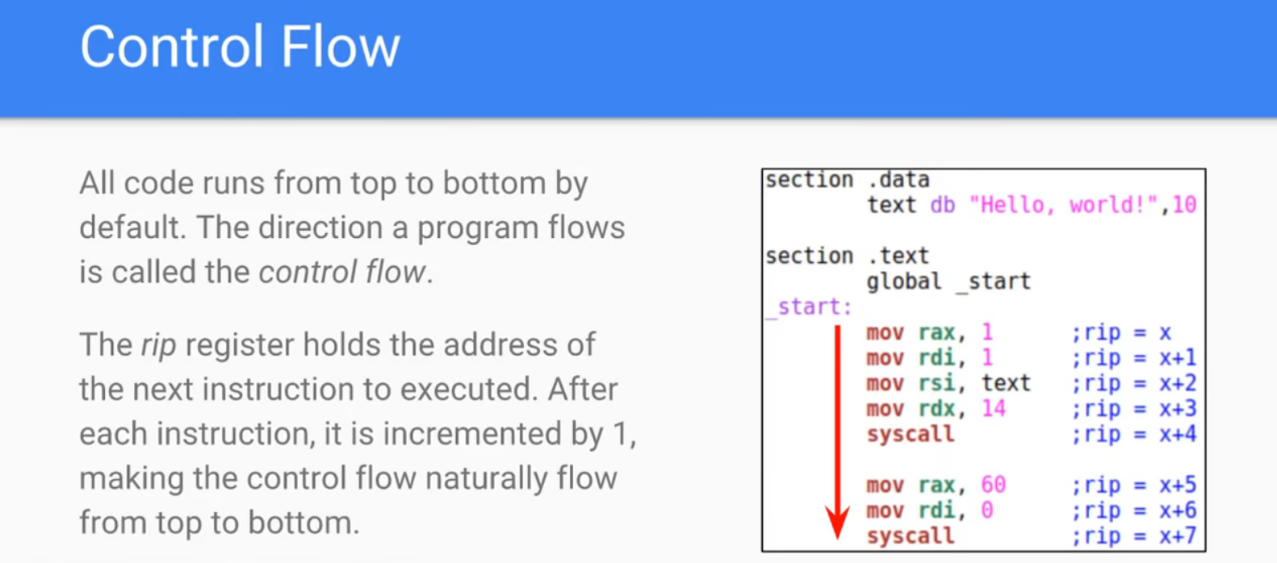

Slide 21
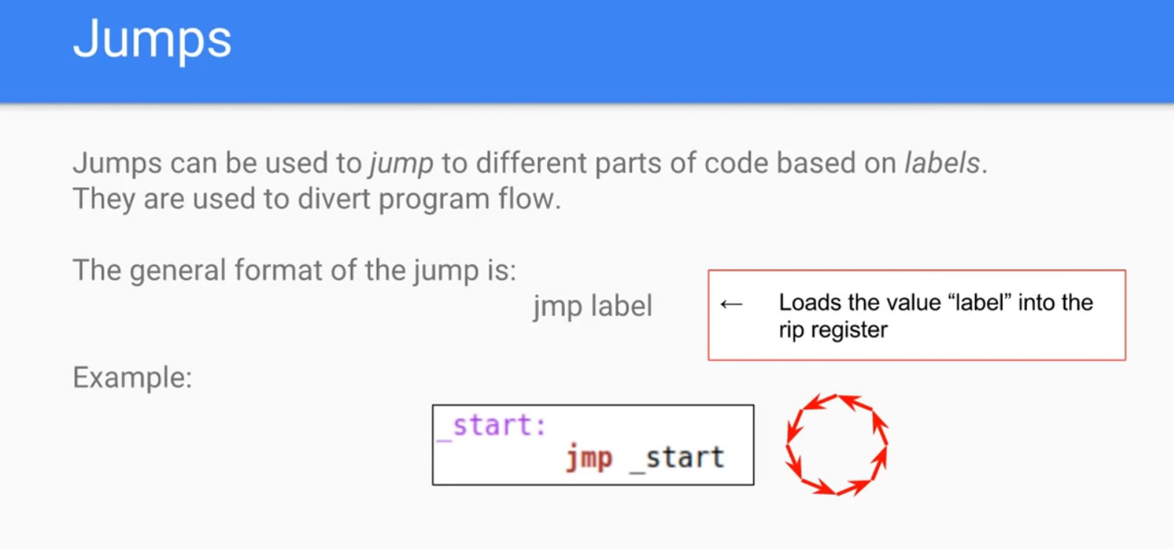

Slide 22
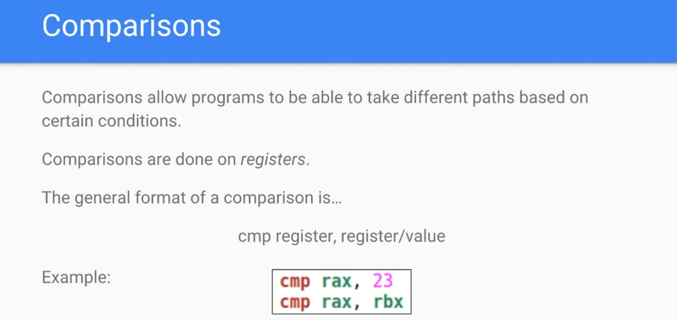

Slide 23
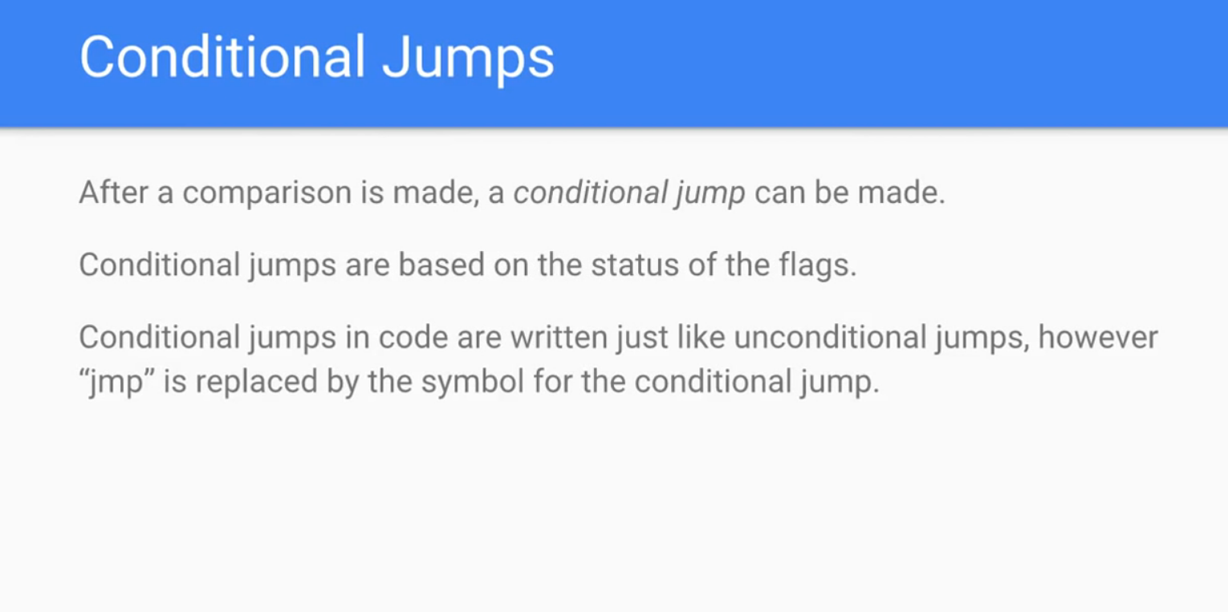

Slide 24
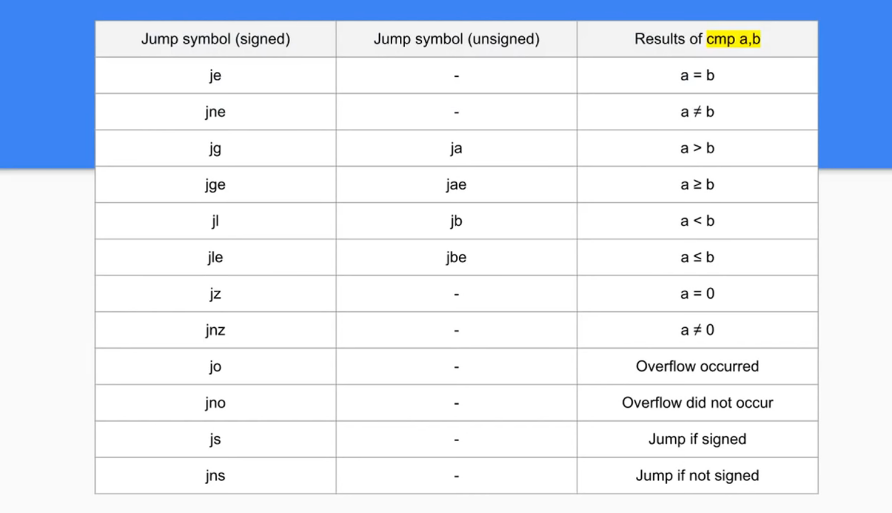

Slide 25
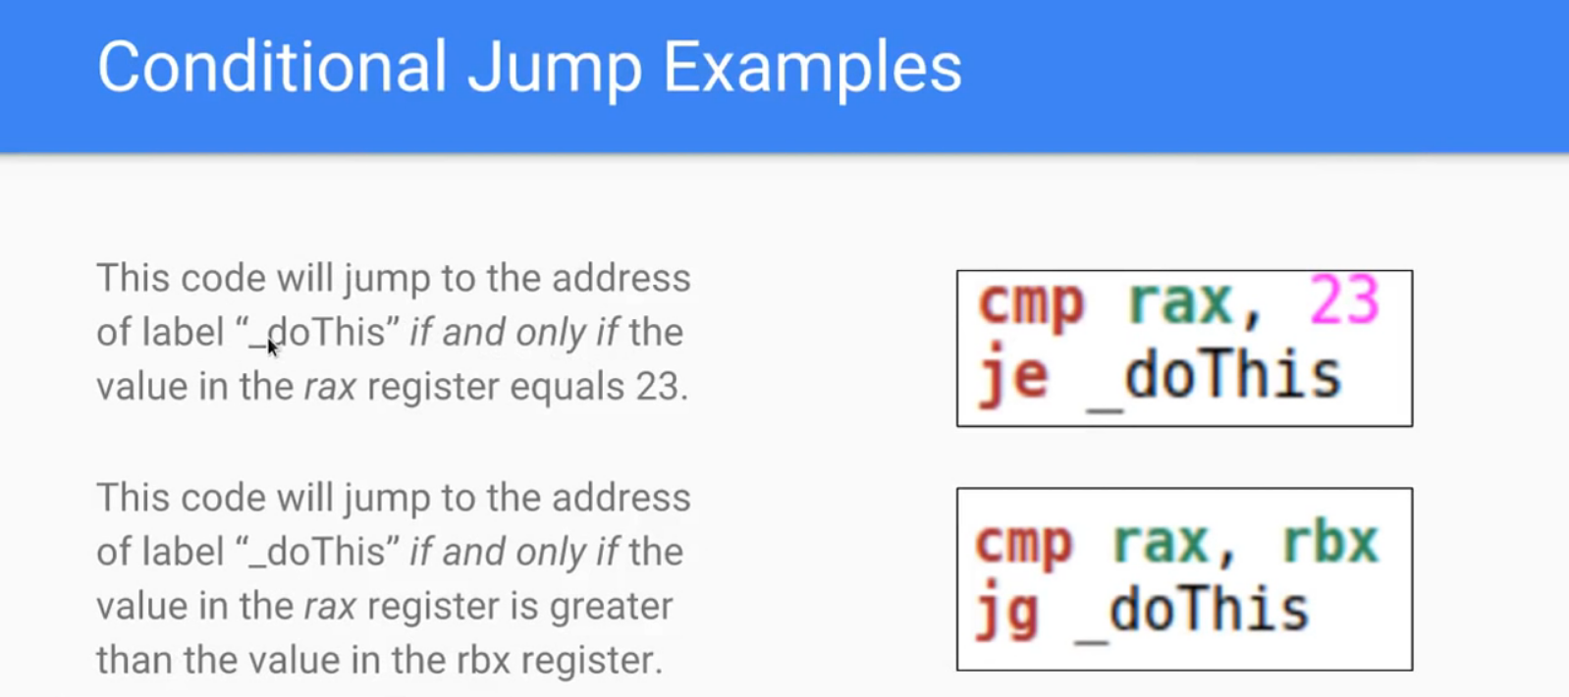

Slide 26
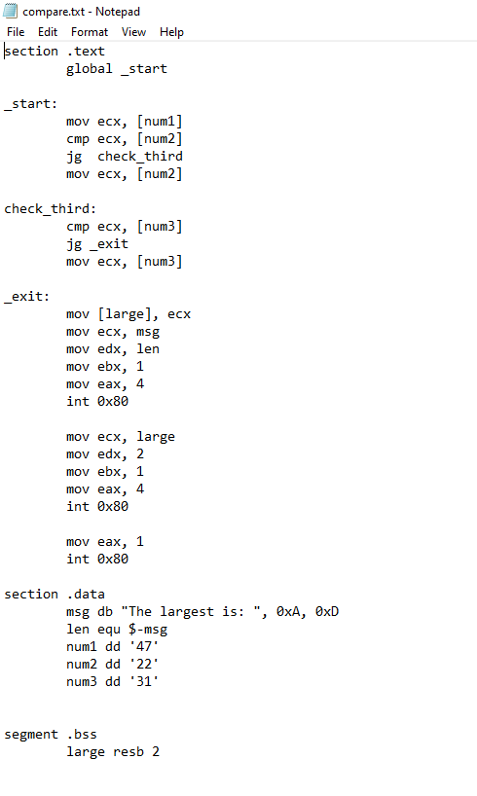
Compare.asm

Slide 27
Compare.asm

Slide 28
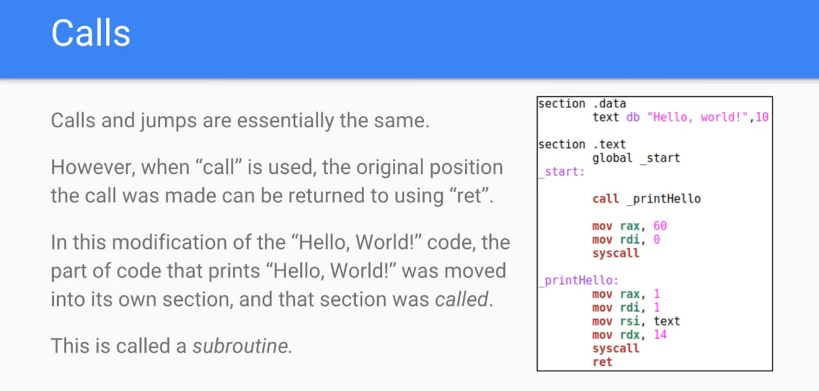

Slide 29
Segment Registers
Segments are specific areas defined in a program for containing data, code and stack. There are three main segments:
Code Segment: it contains all the instructions to be executed. A 16 - bit Code Segment register or CS register stores the starting address of the code segment.
Yeah ! Same thing you know about segments….

Slide 30
Segment Registers
Data Segment: it contains data, constants and work areas. A 16 - bit Data Segment register of DS register stores the starting address of the data segment.
Stack Segment: it contains data and return addresses of procedures or subroutines. It is implemented as a 'stack' data structure. The Stack Segment register or SS register stores the starting address of the stack

Slide 31
Segment Registers
Apart from the DS, CS and SS registers, there are other extra segment registers - ES (extra segment), FS and GS, which provides additional segments for storing data.

Slide 32
Segment Registers
In assembly programming, a program needs to access the memory locations.
All memory locations within a segment are relative to the starting address of the segment.
The segment registers stores the starting addresses of a segment.
To get the exact location of data or instruction within a segment, an offset value (or displacement) is required.

Slide 33
Segment Registers
To reference any memory location in a segment, the processor combines the segment address in the segment register with the offset value of the location.

Slide 34
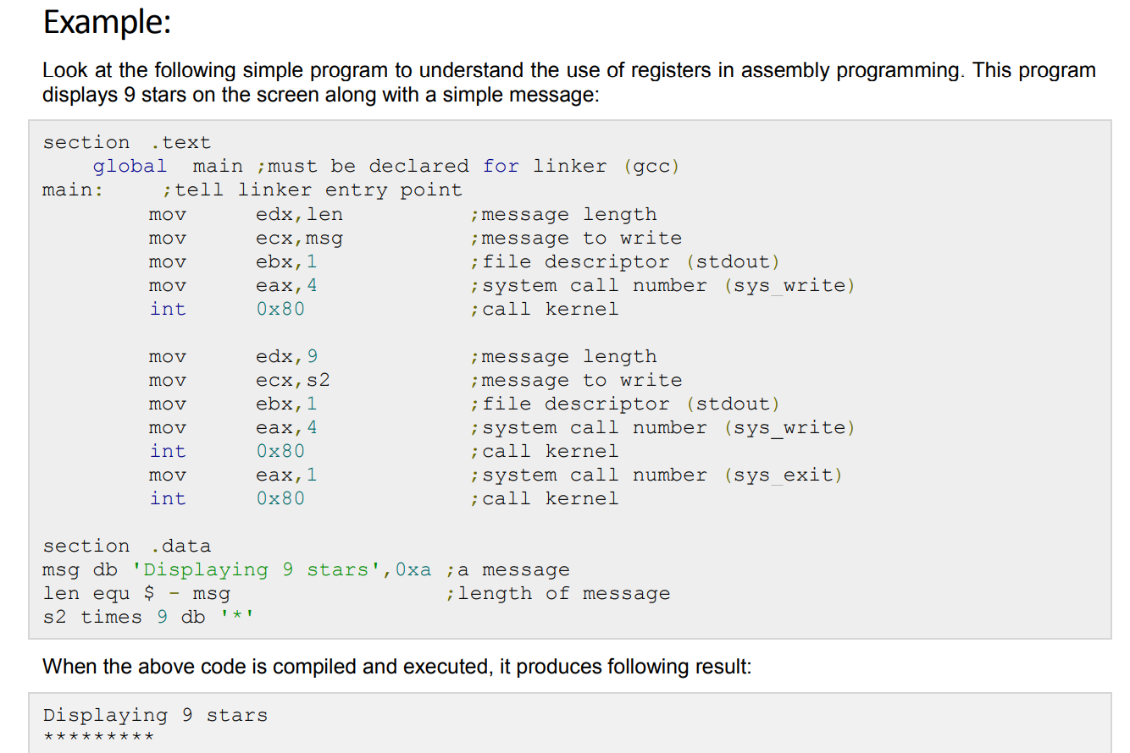
9stars.asm

Slide 35
Assembly System Calls
32/64 bits, Done already. Refer to beyond basics L3
Details for only 32bits are in subsequent slides

Slide 36
Assembly System Calls
System calls are APIs for the interface between user space and kernel space. We have already used the system calls sys_write and sys_exit for writing into the screen and exiting from the program respectively.

Slide 37
Linux System Calls
You can make use of Linux system calls in your assembly programs. You need to take the following steps for using Linux system calls in your program:
Put the system call number in the EAX register.
Store the arguments to the system call in the registers EBX, ECX, etc.
Call the relevant interrupt (80h)
The result is usually returned in the EAX register

Slide 38
Linux System Calls
There are six registers that stores the arguments of the system call used. These are the EBX, ECX, EDX, ESI, EDI, and EBP. These registers take the consecutive arguments, starting with the EBX register. If there are more than six arguments then the memory location of the first argument is stored in the EBX register.

Slide 39
Linux System Calls
The following code snippet shows the use of the system call sys_exit:
mov eax,1 ; system call number (sys_exit)
int 0x80 ; call kernel

Slide 40
Linux System Calls
The following code snippet shows the use of the system call sys_write:
mov edx,4 ; message length
mov ecx,msg ; message to write
mov ebx,1 ; file descriptor (stdout)
mov eax,4 ; system call number (sys_write)
int 0x80 ; call kernel

Slide 41
Linux System Calls
All the syscalls are listed in /usr/include/asm/unistd.h, together with their numbers (the value to put in EAX before you call int 80h).

Slide 42
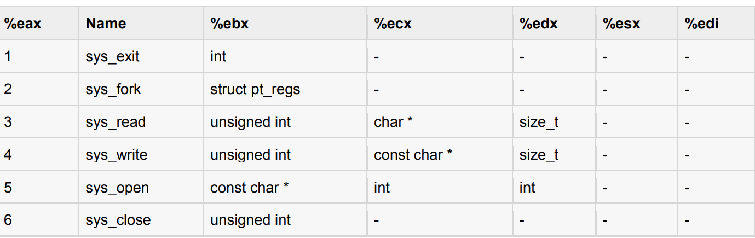
Linux System Calls
The following table shows some of the system calls used in this tutorial:

Slide 43
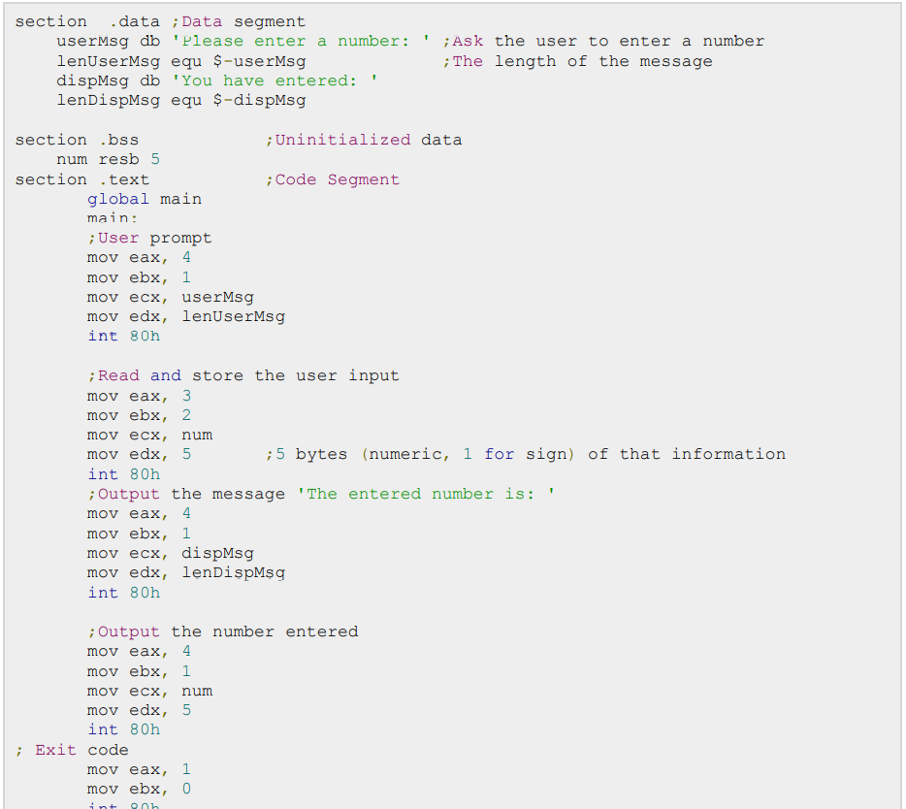
Input.asm

Slide 45
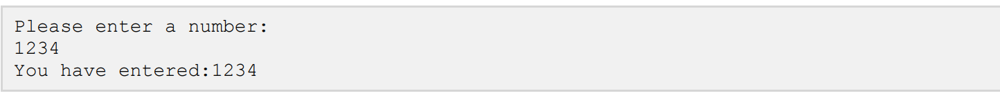
When the above code is compiled and executed, it produces following result

